Slide 1
Designing an app:
introduction to UX / UI design

Slide 2
What is UX and UI design?
and why it’s a super fun job :)

Slide 3

Product design follows an iterative process
Implementation
User research
User testing
User flow
Visual design

Slide 4

User research

Slide 5
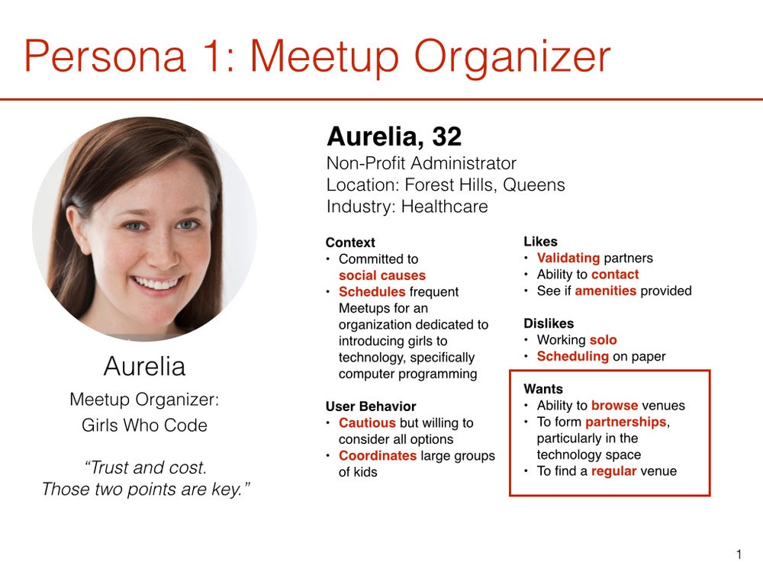
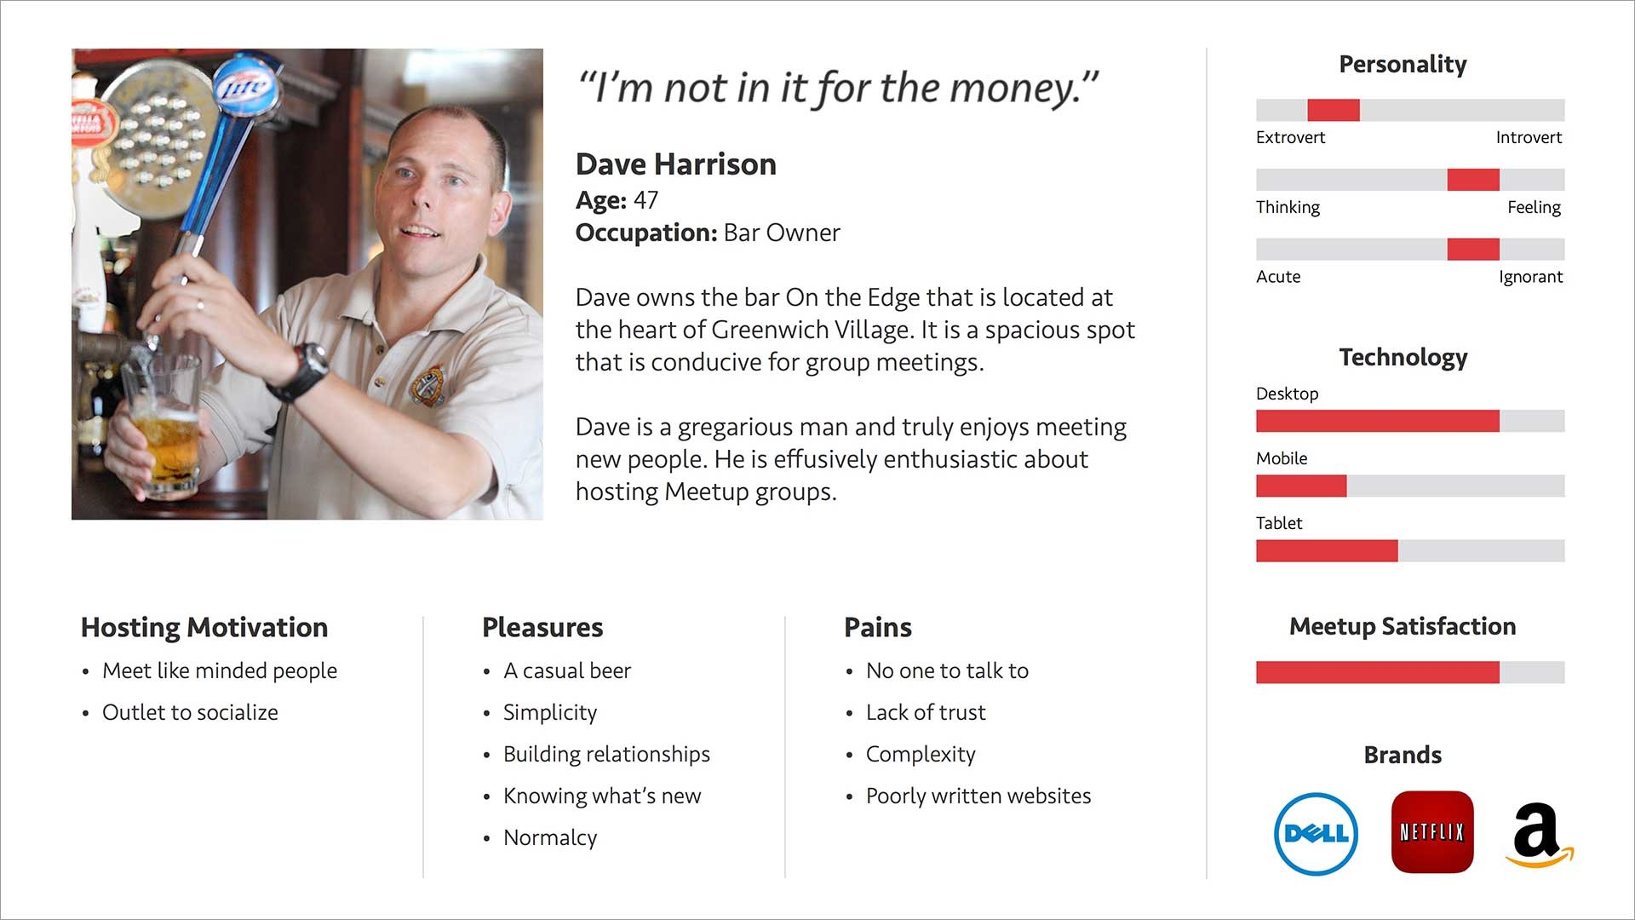
User personas
User Personas are great to help you put yourself in the user’s shoes

Slide 6

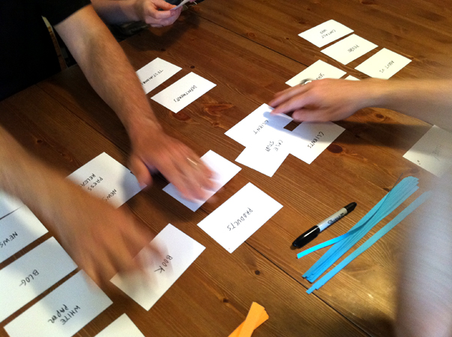
User interviews
observe the user interact with prototypes or implemented designs
ask them to ‘teach’ you how they use the interface to identify pain points
have them sort your product categories their own way (card sorting method)

Slide 7

Creating a user flow

Slide 8
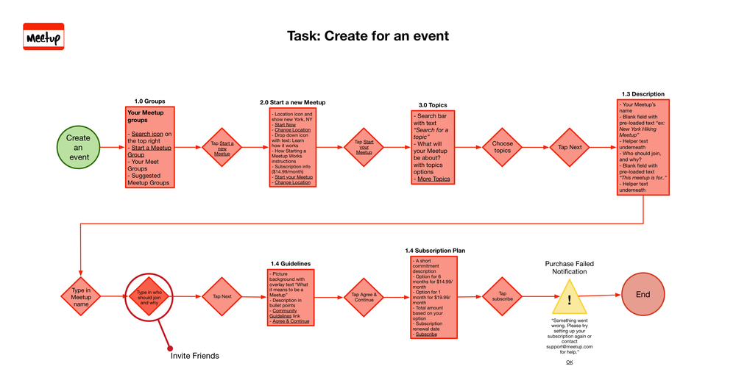
User flow
Test proof your user flow by imagining specific user scenarios

Slide 9

Visual design

Slide 10
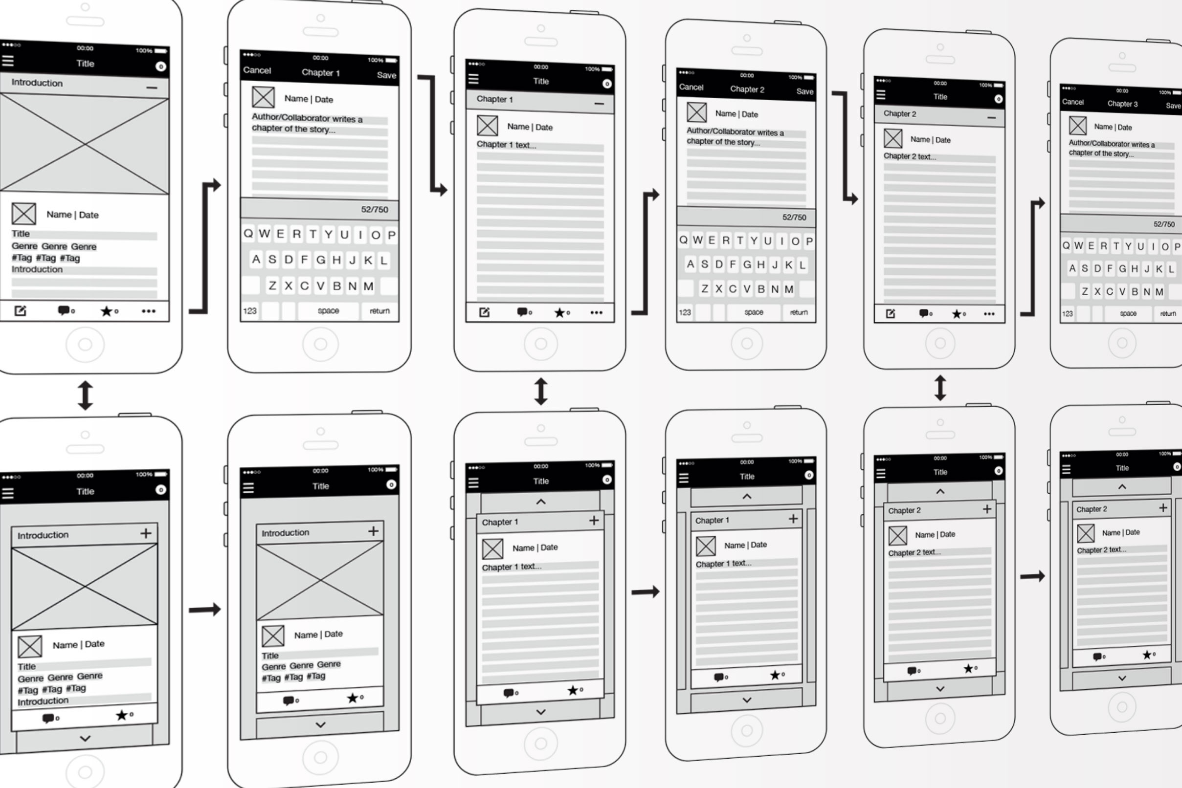
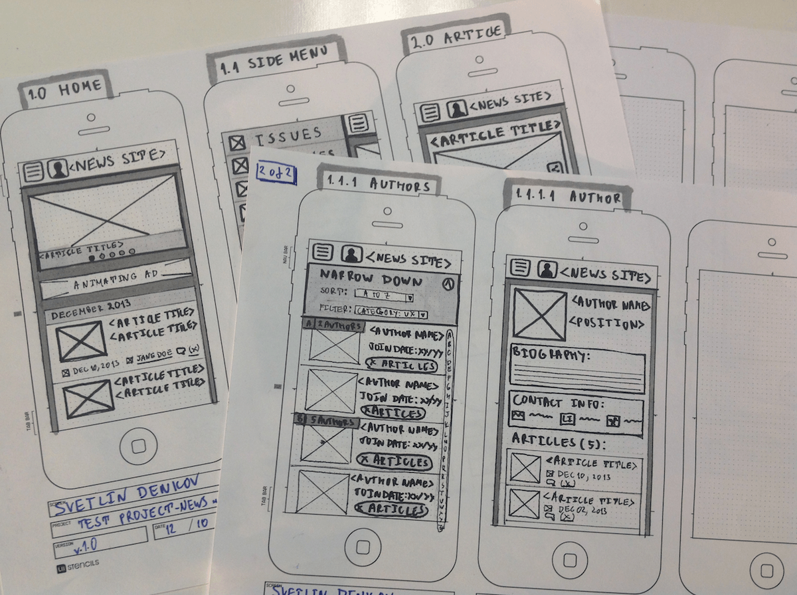
Different fidelities of prototyping
wireframes = drafts of screens to illustrate the user flow, to keep it easy to edit
interactive prototypes = more advanced rendering of the app to mockup the interface
in general you should deliver interactive designs, not static screens

Slide 11
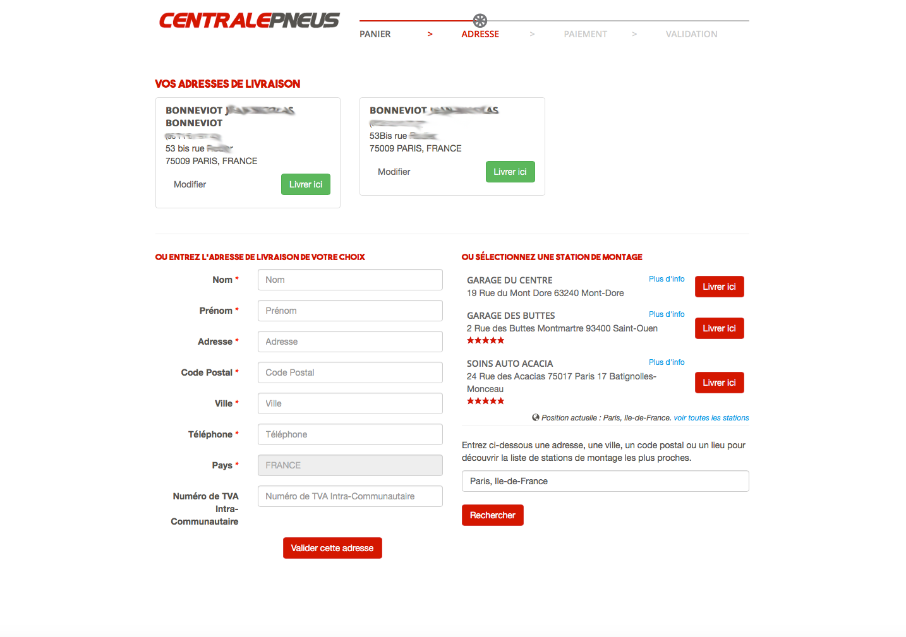
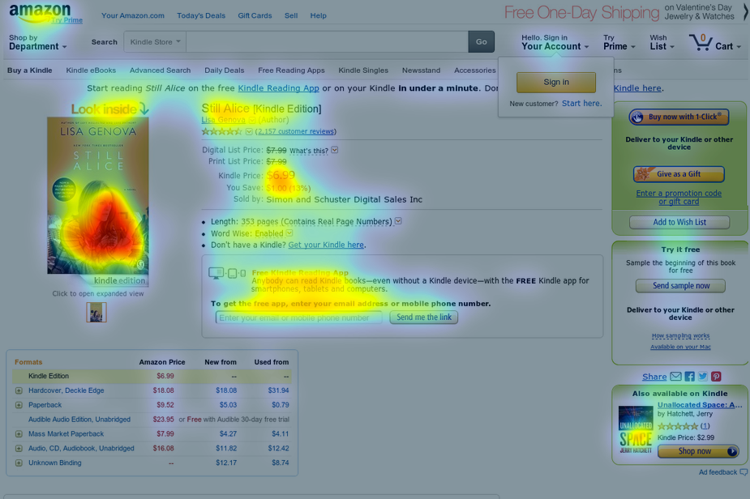
Challenge 1: Users scan the interface
User won’t look at your design, they scan through it
You need to build clear hierarchy of content
Use color sporadically to reflect that hierarchy
Think in terms of volume

Slide 12
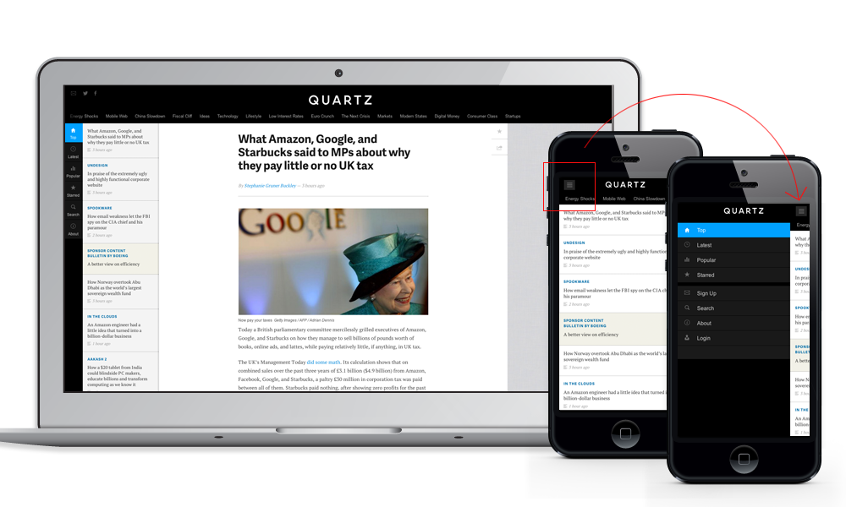
Challenge 2: Designs have to be responsive
The features of your design should stay useable on all screen sizes.

Slide 13

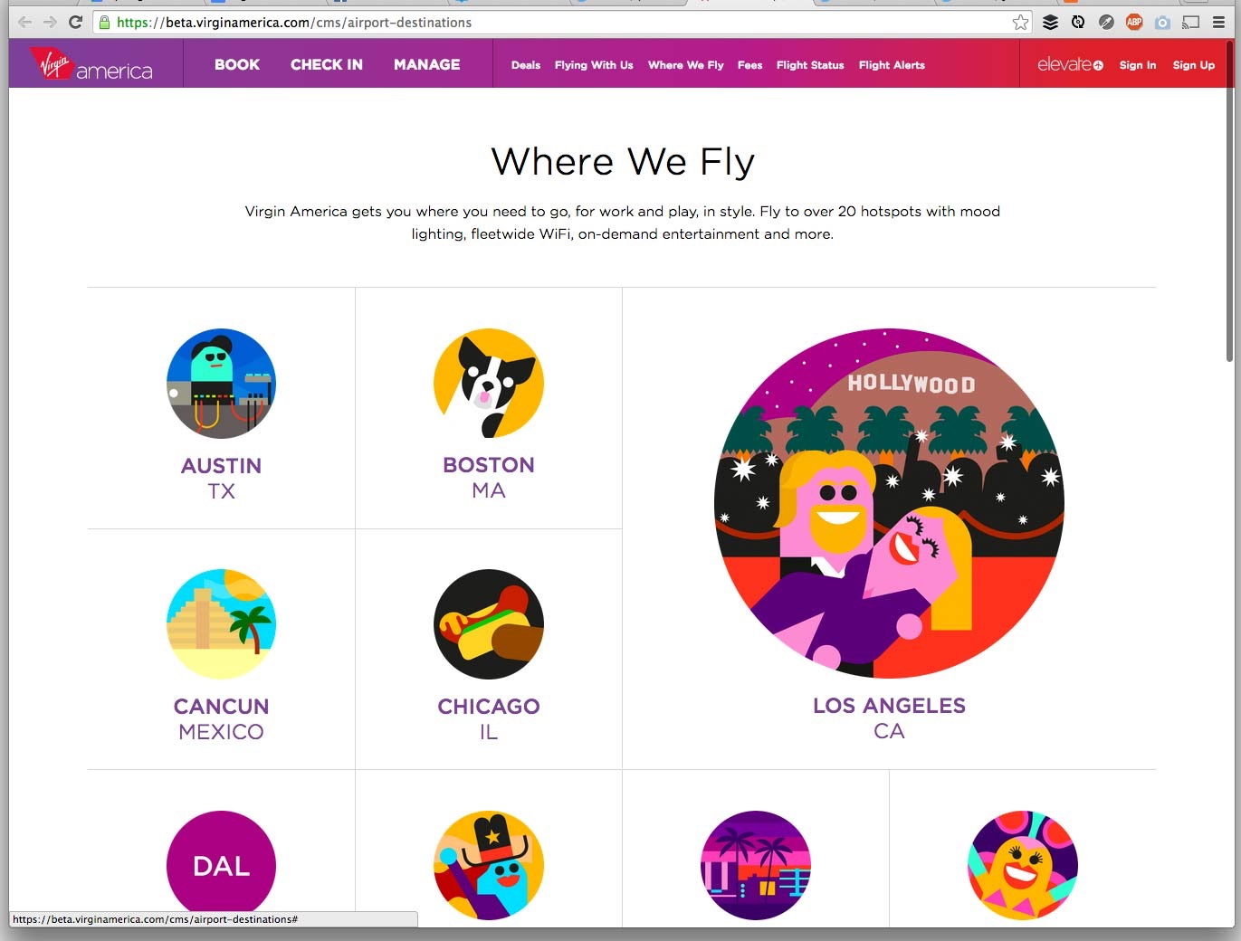
Challenge 3: Designs have to perform fast
Avoid massive JPGs! Performance has a huge impact on conversion
Consider creating friendly text and fun illustrations to bring emotion

Slide 14
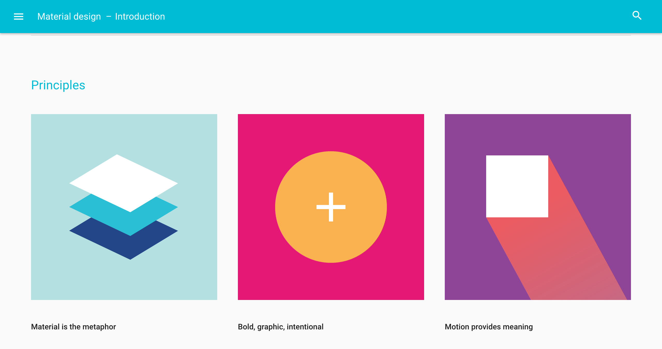
Guidelines for design systems
Android: Material Design
iOS: iOS Human Interface Guidelines
Web: Lightning Design System by Salesforce

Slide 15

User Testing

Slide 16
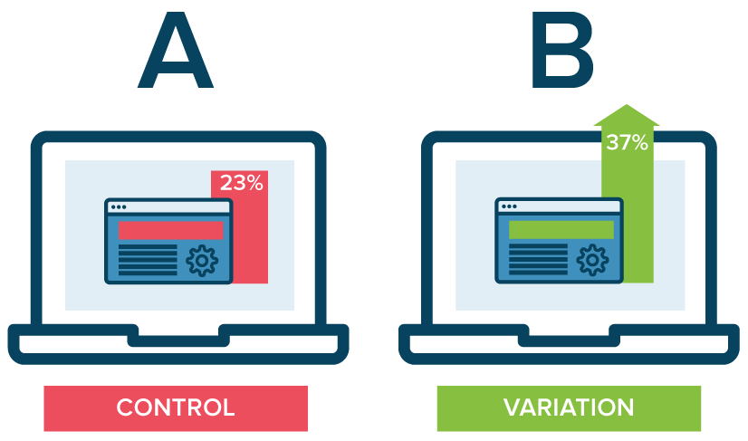
User testing technics, A/B testing
Before the actual release, perform some testing to measure performance

Slide 17

Implementation time!
and now… what’s next?

Slide 18
Product design follows an iterative process
Implementation
User research
User testing
User flow
Visual design

Slide 19
Useful books, links, website
Don't Make Me Think: A Common Sense Approach to Web Usability by Steve Krug
About Face 3: The Essentials of Interaction Design by Alan Cooper, Robert Reimann, David Cronin
Interviewing Users: How to Uncover Compelling Insights by Steve Portigal
Designing for Performance. Weighing Aesthetics and Speed by Lara Callender Hogan
https://www.smashingmagazine.com/
http://www.uxbooth.com/
https://www.nngroup.com/feed/rss/
https://medium.theuxblog.com/
http://uxmovement.com/
https://uxdesign.cc/
http://usabilitypost.com/
http://uxmag.com/uxm.xml
https://uxdesign.cc/ux-design-methods-deliverables-657f54ce3c7d#.3r0kc949k
this is a great website with further links and reading lists, the ‘methods and deliverables’ section
is where I first learnt a lot of the skills I use in my everyday job

